Slide 1
CSE322
Regular Expressions and
their Identities

Slide 2
Regular Expressions
1. terminal symbol Λ and ∅ are regular expression
(R 1 + R2) is regular expression.
R1. R2, is also a regular expression.
R*, is regular expression.

Slide 3
Definitions
Any set represented by a regular expression is called a regular set.
If for example, a, b ε ∑. Then
a denotes the set {a},
a + b denotes {a, b},
ab denotes {ab},
a* denotes the set {lambda, a, aa. aaa, ... } and
(a + b)* denotes {a, b}*. The set represented by R is denoted by L(R),

Slide 4
Questions
Describe the following sets by regular expressions:
{101}
{abba}
{01,10}
{Λ ,ab}
{abb,a, b, bba}
{Λ , 0, 00, 000.... }
{1, 11, 111 ... }

Slide 5
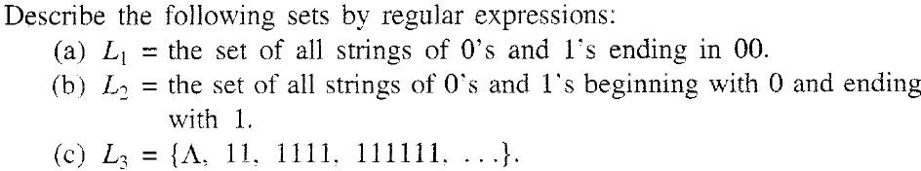
Problem

Slide 6
Which of the following does not represents the given language?
Language: {0,01}
0+01
{0} U {01}
{0} U {0}{1}
{0} ^ {01}

Slide 7
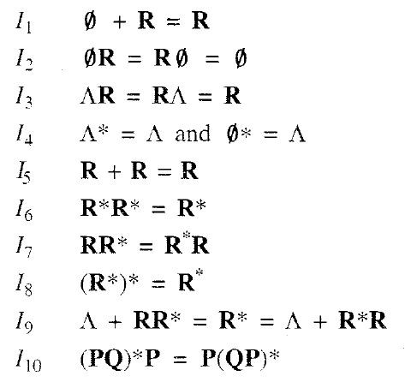
IDENTITIES FOR REGULAR EXPRESSIONS

Slide 8
ARDEN’S THEORM
Theorem :
(Arden' s theorem) Let P and Q be two regular expressions over ∑. If P does not contain Λ, then the following equation in R, namely
R = Q + RP
has a unique solution (i.e. one and only one solution) given by R = QP*.

Slide 9
PROOF

Slide 10
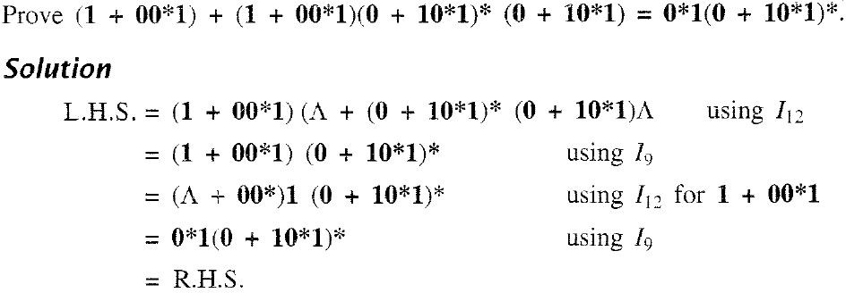
PROBLEM

Slide 11
TRANSITION SYSTEM CONTAINING Λ -MOVES
Suppose we want to replace a Λ -move from vertex S1 to vertex S2 Then
we proceed as follows:
Step 1- Find all the edges starting from S2.
Step 2- Duplicate all these edges starting from S1 without changing the edge
labels.
Step 3- If S1 is an initial state, make S2 also as initial state. Step 4- If S2 is a final state. make S1 also as the final state.

Slide 12
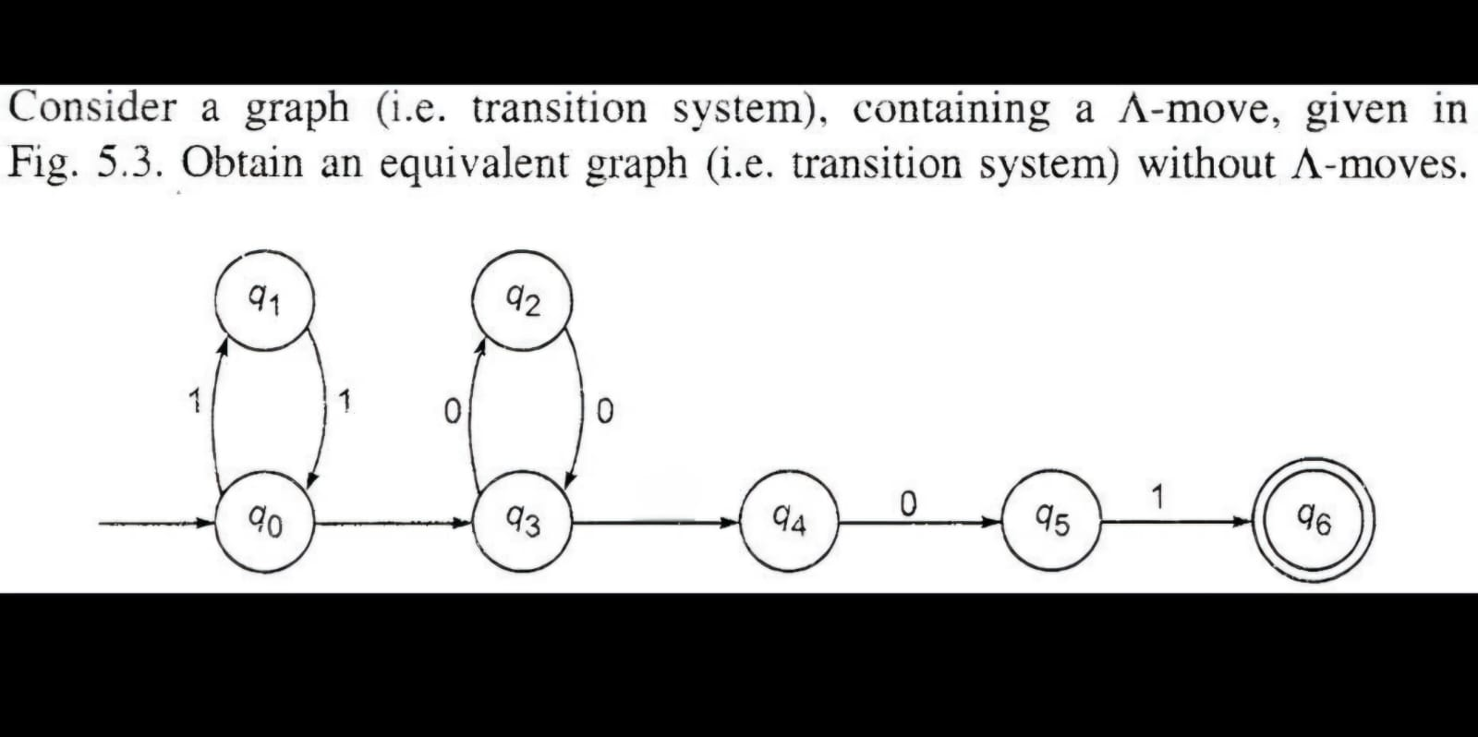
EXAMPLE

Slide 13
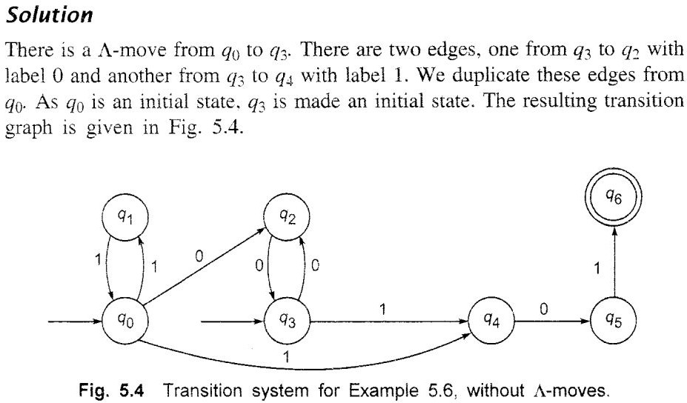

Slide 14
Concatenation of R with Ф outputs:
R
Ф
R.Ф
None of the mentioned

Slide 15
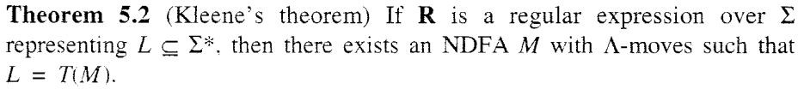
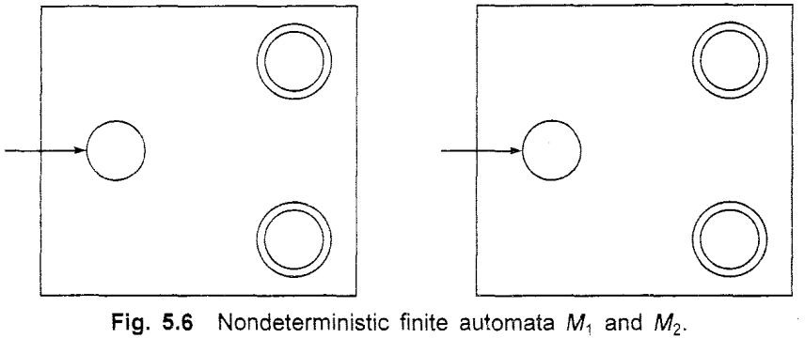

Slide 16
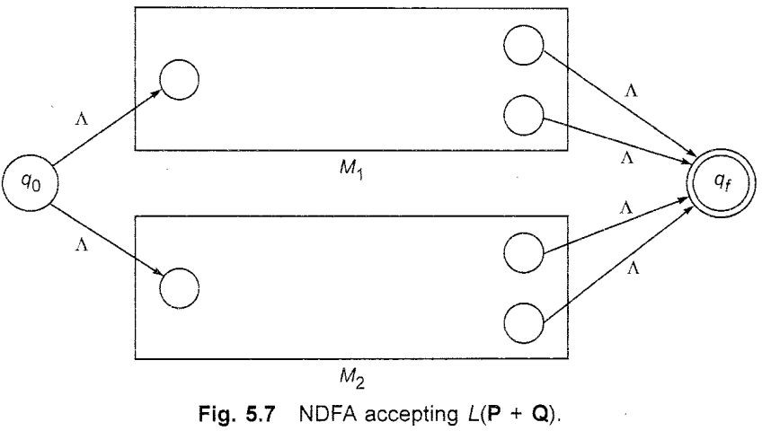

Slide 17
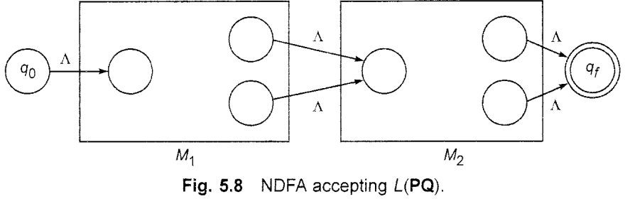

Slide 18
